Slide 1
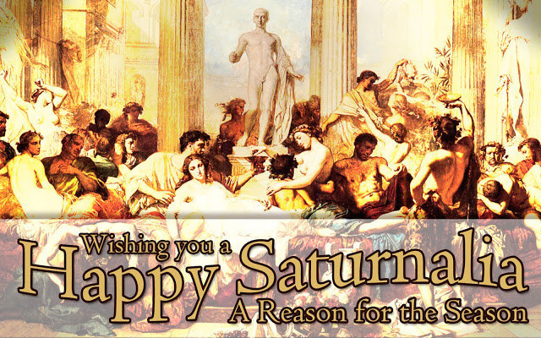
Christmas Origins
Notes:
Many of our Christmas customs have their origins in Saturnalia. Saturnalia was a pagan observance of the birthday of the unconquered sun which was marked by feasting, parades, special music, giving of gifts, lighted candles and green trees. It occurred around December when the days start getting longer. As Christianity spread in the Roman Empire, the pagan holiday was Christianized. In 336 AD Emperor Constantine declared Christ's birthday an official Roman holiday. Some rebuke Christians for adopting it, the pilgrims did not observe it, but the date endures to this day, now bigger than ever.
The true origins a true Christian Christmas begins with a Christmas prophecy.

Slide 2
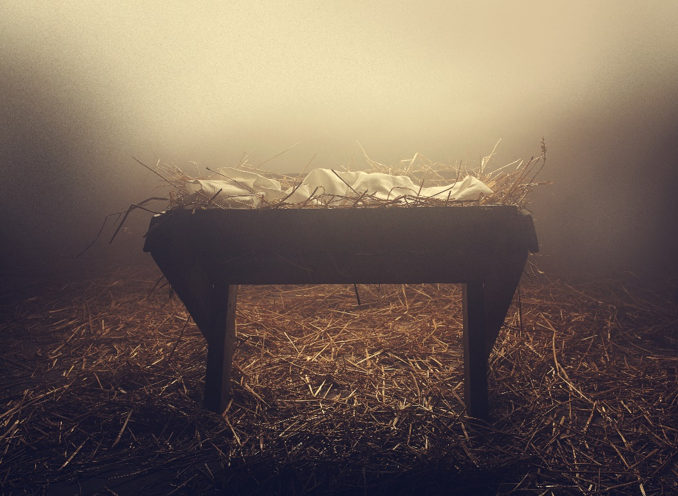
The Savior King
A Christmas Prophecy
Isaiah 9:6-7
Notes:
Isaiah gives a description of the coming Savior King, a child to be born and a son to be given, He is the God/Man, the King of Kings. He will be called Wonderful Counselor, Mighty God, Everlasting Father, Prince of Peace. He will rule a Kingdom free of confusion, chaos, complexity, and conflict. His kingdom will endure forever there will be no end to His Kingdom. He will rule this Kingdom on the earth in Jerusalem sitting on David’s throne. He is the King of David, the king of Israel. His kingdom will be characterized by justice and righteous for all time. And the Lord is very determined to bring this about.

Slide 3
The Savior King
A Christmas Lineage
Matthew 1:1-17
Notes:
The Purpose of this section is to show that Jesus “Yahweh Saves” had a claim to the throne of Israel through His Messianic ancestry. Matthew gives evidence that Jesus inherited the legal right to rule through stepfather Joseph. Jesus could claim the right to kingship because He was the son of David, king of Israel.

Slide 4
The Savior King
The Prophets Predicted a Literal, Tangible, Earthly, Davidic Kingdom.
The Jewish Nation Expected a Literal, Tangible, Earthly Davidic Kingdom.
The Disciples Expected a Literal, Tangible, Earthly Davidic Kingdom.
Jesus Expected a Literal, Tangible, Earthly Davidic Kingdom.

Slide 5
The Savior King
The Early Church Expected a Literal, Tangible Earthly Davidic Kingdom.
Many Jews today Expect a Literal, Tangible, Earthly Davidic Kingdom.
Christians today Expect a Literal, Tangible, Earthly, Davidic Kingdom.
TLBC Expects a Literal, Tangible, Earthly, Davidic Kingdom.
Notes:
Of the few early Christians who wrote concerning the future millennial kingdom, nearly all of the available writings from the period reflect a millennialist perspective, referred to as the chiliasm, a thousand. Bishop Papias of Hierapolis (A.D. 70-155) speaks in favor of a pre-millennial position and the Aristion and the Elder John echoed his sentiments, as did other first-hand disciples and secondary followers. The only Amillennial or no-millennial, or no earthly kingdom position in the early period was suggested in the Epistle of Barnabas (a fake epistle) also a Gnostic letter. The Gnostics denied that Jesus had come in the flesh, since the flesh was inferior and evil. They also did not expect a literal, tangible, earthly Davidic Kingdom for the same reason.
With the influencer of Neo-Platonism and dualism (an adoption of Greek philosophy into Christian theology) Clement of Alexandria and Origen denied premillennialism, they did not expect a future earthly Davidic Kingdom. Origen’s romanticizing tendencies considered only the spiritual as real, and commented the Chiliasm of a physical kingdom as rude or crude.
The no earthly kingdom view “Amillenialism” gained significant ground with the endorsement of St. Augustine, a former member of a Gnostic cult, when he systematized this view. When he first converted to Christianity he was a millennialist, but retracted that view, claiming the doctrine was carnal.

Slide 6
The Savior King
We believe that the period of great tribulation in the earth will be climaxed by the return of the Lord Jesus Christ to the earth as He went, in person on the clouds of heaven, and with power and great glory to introduce the millennial age, to bind Satan and place him in the abyss, to lift the curse which now rests on the whole creation, to restore Israel to her own land and to give her the realization of God's covenant promises, and to bring the whole world to the knowledge of God.

Slide 7
The Savior King
A Christmas Fulfillment
Matthew 1:18-25
Notes:
The fact that Jesus was born “of Mary” only as indicated in the genealogical record (1:16) demands further explanation. How is it that Joseph is merely the husband of Mary, but not the father of Jesus?
Although Jesus is the a legal descendent of King David through Joseph, Jesus is no ordinary King. He is human proved by His human ancestry, but is also divine, as demonstrated by His names “Jesus” and “Immanuel” and manner of His miraculous conception.

Slide 8
The Savior King
The Discovery of the Child
Matthew 1:18
Notes:
The story of the birth of Jesus begins with a young Jewish girl by the name of Mary who was betrothed to a young man named Joseph.

Slide 9
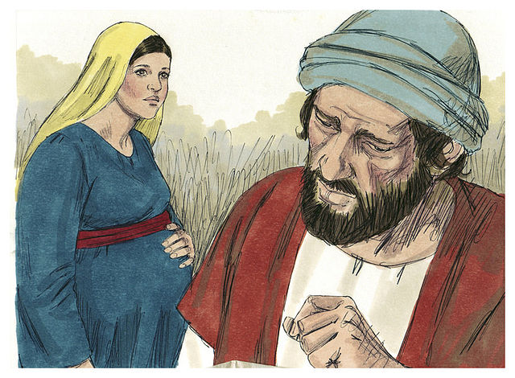
The Savior King
“Now the birth of Jesus Christ was as follow: After His mother Mary was betrothed to Joseph, before they came together, she was found with child of the Holy Spirit.” (1:18)

Slide 10
The Savior King
The Angel Gabriel announces to Mary concerning her conception and birth.
Mary is conceived by the Holy Spirit.
Mary traveled from Nazareth to a city in Judah to visit Elizabeth and stays three months.

Slide 11
The Savior King
“Now Mary arose in those days and went into the hill country with haste, to a city of Judah, and entered the house of Zacharias and greeted Elizabeth. And it happened, when Elizabeth heard the greeting of Mary, that the babe leaped in her womb; and Elizabeth was filled with the Holy Spirit…”

Slide 12
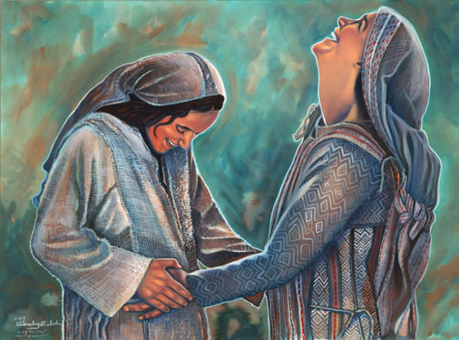
The Savior King
“Then she spoke out with a loud voice and said, "Blessed are you among women, and blessed is the fruit of your womb.” (Luke 1:39-42)

Slide 13
The Savior King
The Angel Gabriel announces to Mary concerning her conception and birth.
Mary is conceived by the Holy Spirit.
Mary traveled from Nazareth to a city in Judah to visit Elizabeth and stays three months.
When Mary returns Joseph discovers that she is pregnant.

Slide 14
The Savior King
“Now the birth of Jesus Christ was as follow: After His mother Mary was betrothed to Joseph, before they came together, she was found with child of the Holy Spirit.” (1:18)
Notes:
Notice: Matthew tells us that Mary was the mother of Jesus, but the Scriptures never tells us that Joseph was the father of Jesus. Luke only tells us that, “Now Jesus Himself began His ministry at about thirty years of age, being (as was supposed) the son of Joseph,…” (3:23)
“before they came together” simply means they had not yet cohabited together, or living together, not that they necessarily had not had sexual relations, but it implies this. All Joseph knows is that she is with child, pregnant and it is not his. Apparently Mary had not yet told Joseph of the conception and the announcement by the angel. He did not know it was of the Holy Spirit.
The betrothal was made, (a legally binding agreement) dowry gifts were sent, (the dowry was a payment sent to the parents by the groom), friends and family had been informed.

Slide 15
The Savior King
Parents arrange a marriage.
An legally binding engagement is made with a dowry given to the parents of the bride by the groom.
The couple is considered married.
The groom prepares a place for the new couple to live, which may take several months, to years.
Notes:
According to Hebrew marriage customs: Marriages were arranged for individuals by parents and contracts were negotiated… (Bible Knowledge Commentary, p. 20)

Slide 16
The Savior King
First Ceremony: the wedding procession were the grooms friends, usually at night, fetch the bride and here attendant to the grooms home.
Second Ceremony: The marriage supper followed in the home of the groom.
Then the couple began to live together.
Notes:
First Ceremony – the parable of the ten virgins (Mt. 15:1-13)
Second Ceremony – the parable of the wedding banquet (Mt. 22:1-14)

Slide 17
The Savior King
The Dilemma Over the Child
Matthew 1:19
Notes:
When Joseph discovers Mary is with child he is faced with a momentous decision regarding his bride.

Slide 18
The Savior King
“Then Joseph her husband, being a just man, and not wanting to make her a public example, was minded to put her away secretly.” (1:19)

Slide 19
The Savior King
During this one year waiting period, Mary was found with child.
The Dilemma: what to do?
Joseph was a just man and loved Mary. Therefore he decided to not to make it a public spectacle or scandal.
Such an act could result in Mary’s death by stoning.
Notes:
The Mosaic Law said, “But if the thing is true, and evidences of virginity are not found for the young woman, then they shall bring out the young woman to the door of her father’s house, and the men of her city shall stone her to death with ﻿﻿stones, because she has ﻿﻿done a disgraceful thing in Israel, to play the harlot in her father’s house.” (Deut. 22:20-21)

Slide 20
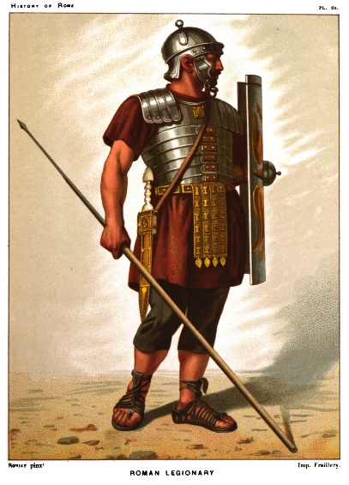
The Savior King
Instead Joseph decide to divorce her quietly in order to avoid public disgrace.
“Then they said to Him, ‘We were not born of fornication;…” (John 8:41)
Notes:
Some say that the Jewish leaders may have known about the circumstances of Jesus’ birth and are slandering Jesus concerning his origin. Were they implying that He was born illegitimately? They say in verse 48, “Do we not say rightly that You are a Samaritan and have a demon?”
A slanderous story would later be told that a passing Roman soldier impregnated Mary. In the eight century a fake story was told that a neighbor who came in the dark and had sex with her. Mary assumed it was Joseph. Others say that early Christians simply made of the story of the virgin birth in its zeal to prove Jesus’ deity.
But no one offers no any proof, none of the fake news has any basis in historical fact, its sole purpose is to cast doubt and make Jesus illegitimate and remove His divine nature. They only want to invalidate Jesus’s claim to be the Messiah and the King of Israel. “If the virgin birth were anything less than literal in the fullest sense, Christ would be just another man. And that is what the adversaries of the virgin birth want to prove.” (John MacArthur, the Miracle of Christmas, p. 42)
Then there are the many virgin birth counterfeits. Greek mythology taught that Dionysus was born out of union with his physical mother and the divine god Zeus. The Assyrian myth was that the wife of Nimrod was supposedly conceived by a sunbeam. The Egyptians absorbed the same myth between Isis and Osiris. In India the same tale is told of Isi and Iswara. The Chinese have evidence of an ancient mother cult known as Shing Moo. Buddha claims he was miraculously conceived when an elephant entered his mother’s belly. Olympias, the mother of Alexander the Great, often asserted that he was conceived by the gods.
Then there is the doctrine of Immaculate Conception, an invention of the Medieval church, that teaches that Mary herself was conceived in her mother’s womb as a sinless being, preserved from effects of Adam’s sin. This elevates Mary’s own conception and birth as supernatural, and elevates her to a higher status, becoming a object of veneration (worship). This of course then devalues Jesus’ own virgin birth.
These counterfeits have only obscured the real truth to the world. Just another lie of the Deceiver to confuse the world.
The fact is, there is a direct parallel between the Pharisees and the religious skeptics of today who hint at the virgin birth as either unimportant or nothing more than a myth or fable. Their skepticism and mockery grow out of unbelief, the expression of sinful, undegenerated mind. But all of the bizarre myths of stand in stark contrasts to the simply reality of Jesus’ conception.

Slide 21
The Savior King
Instead Joseph decide to divorce her quietly in order to avoid public disgrace.
“Then they said to Him, ‘We were not born of fornication;…” (John 8:41)
While Joseph thought about these things, he fell asleep.

Slide 22
The Savior King
The Dream About the Child
Matthew 1:20-23
Notes:
An angel, a messenger from God, comes to Joseph in a dream to explain Mary’s conception.

Slide 23
The Savior King
“But while he thought about these things, behold, an angel of the Lord appeared to him in a dream, saying, "Joseph, son of David, do not be afraid to take to you Mary your wife, for that which is conceived in her is of the Holy Spirit.” (1:20)

Slide 24
The Savior King
While Joseph slept an unnamed angel appears to him in a dream.
The angel appears in order to clear up any apprehension Joseph had of taking Mary to be his wife.
The angel informs Joseph that Mary’s condition was not the result of man, but of God, by the Holy Spirit.
Notes:
Joseph was not to be afraid of taking Mary to be his wife. “There would be misunderstanding in the community and much gossip at the well, but Joseph knew the true story of Mary’s pregnancy and God’s will for his life.” (Bible Knowledge Commentary, p. 20)
The conception was supernaturally produced. The “virgin birth” as one of the five fundamental of the “Fundamentalist”. The non-fundamentalist were anti-supernaturalist. The liberals or religious progressives of the day believed the virgin birth did not happen, because it could not happen. A supernatural events, like the virgin birth, were impossible, since the supernatural does not exist. This was the modernist view.
The pre-modern view had a high regard for Scripture, the modern view had a low regard of Scripture, the post-modern has no regard for Scripture.

Slide 25
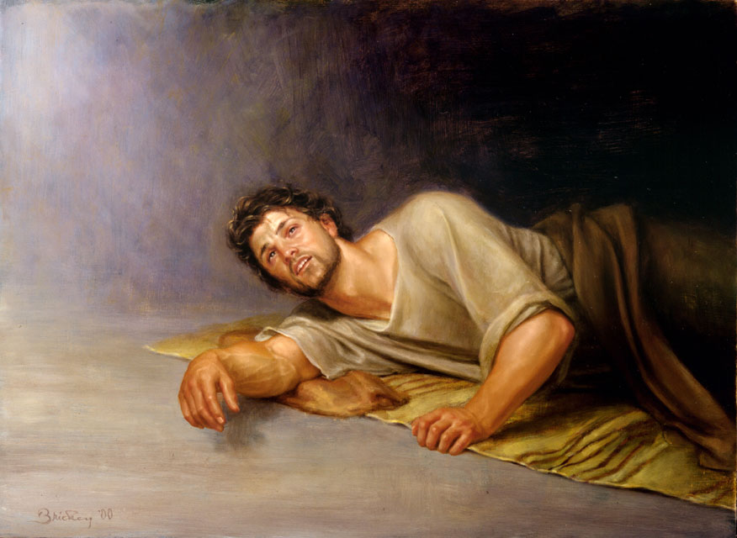
The Savior King
The angel address “Joseph, son of David” as a reminder that it was through the house of David that the messianic king was to come.

Slide 26
The Savior King
“And she will bring forth a Son, and you shall call His name Jesus, for He will save His people from their sins.”(1:21)

Slide 27
The Savior King
The angel further informs Joseph that Mary will have “a Son”.
He is instructed to call His name Jesus, which means “Yeshua Saves”.
Why is His name to be Jesus? For this Son will save His people from their sins.
Notes:
Jesus means “Yahweh is Savior” – The salvation that Jesus came to offer was both physical and spiritual.
Spiritually he offers free forgiveness of sins to His people and He is also the Lamb of God that takes away the sins of the whole world. He offers this free forgiveness of sins on the basis of his impending death and resurrection. And He offers this free forgiveness of sins on the criteria that He is God incarnate, for only God could forgive sin (Mk. 2:5-7).
Physically, Jesus would restore collectively the nation of Israel “His people” to a place of prominence. He would deliver the nation as a whole from the consequences of her sins.
Zech. 9:9
"Rejoice greatly, O daughter of Zion! Shout, O daughter of Jerusalem! Behold, your King is coming to you; He is just and having salvation,…”

Slide 28
The Savior King
“Rejoice greatly, O daughter of Zion! Shout, O daughter of Jerusalem! Behold, your King is coming to you; He is just and having salvation…” (Zech. 9:9)

Slide 29
The Savior King
“So all this was done that it might be fulfilled which was spoken by the Lord through the prophet, saying: ‘Behold, the virgin shall be with child, and bear a Son, and they shall call His name Immanuel,’ which is translated, ‘God with us.’” (1:22-23)
Notes:
All this was done, that is, the conception by the Holy Spirit, to fulfill a prophecy given some 700 years earlier.

Slide 30
The Savior King
Matthew interrupts the story?
This “Son” to be given is in keeping with God’s eternal plan, a fulfillment of Isaiah’s prophecy that a “virgin shall be with child”.
A second name shall be given to this child, “Immanuel”, “God with us”.
Notes:
The original Hebrew “almah” is a broad term which could refer to any young women of marriageable age and also a virgin. The Greek word “parthenos” is a very narrow term meaning virgin only. Mary’s miraculous conception fulfills Isaiah’s prophecy.
His name reflects His divine nature and presence, “Immanuel” original Hebrew, translated into Greek meaning “God with us”.

Slide 31
The Savior King
The Decision About the Child
Matthew 1:24-25

Slide 32
The Savior King
“Then Joseph, being aroused from sleep, did as the angel of the Lord commanded him and took to him his wife, and did not know her till she had brought forth her firstborn Son. And he called His name Jesus.” (1:22-24)
Notes:
After Joseph was awakened he did just as the angel instructed him to do. He immediately took Mary to be his wife violating all customer procedures by taking Mary into his home, not waiting till the one-year time period of betrothal had passed.
Joseph “did not know her” – that is, he did not have sexual relationship with her until after Jesus was born. It does not say he never knew her, for they did have sexual relations and bore other children, Jesus’ half brothers and sisters (Mt. 12:46; Ml. 6:3). Mary did not remain a virgin. Nor is there any evidence that Mary herself was born of a virgin, that is her mother was a virgin as well and there is no evidence that Mary remained sinless.
Matthew simply noted the birth of the Child and the fact that he called His name Jesus, just as the angel had instructed. Whereas, Luke records several details surrounding the His physical birth.

Slide 33
The Savior King
Conclusion
Notes:
“Immanuel, infinitely rich, became poor. He assumed our nature, entered our sin-polluted world, took our guilt on Himself although He was sinless, bore our griefs, carried our sorrows, was wounded with our transgressions, bruised for our iniquities. All of that was wrapped up in the phrase. “God with us”.
The apostle Paul penned… “You know the grace of our Lord Jesus Christ, that though He was rich, yet for your sake He became poor, that you though His poverty might become rich” (2 Cor. 8:9)
Jesus is the greatest gift to mankind, God’s gift of Christmas. Christ, God’s own Son, who gave up His wealth and privilege to live with us, that He might save His people from their sins and that we through His poverty might become rich.” (John MacArthur, The Miracle of Christmas, p. 61-61).

